Slide 1
Improving Modern Techniques of Causal Inference: Finite Sample Performance of ATM and ATO Doubly Robust Estimators, Variance Estimation for ATO Estimators, and Contextualized Tipping Point Sensitivity Analyses for Unmeasured Confounding
Lucy D’Agostino McGowan

Slide 2
Thank you!
Notes:
Committee, Robert, Frank, Cindy, and Peter
Cohort: Alice and Alice, Svetlana, Jonathan, and Ryan
Jacquelyn, Alli, Mark
Family

Slide 3
What method should I use?
What if I’ve missed something?
How should I estimate my effect and variance?

Slide 4
Background

Slide 5

Observational Studies
exposure
outcome

Slide 6
Observational Studies
Randomized Controlled Trials
Treatment
P=0.5
Control
P=0.5

Slide 7
Observational Studies
Treatment
P=0.9
Control
P=0.1

Slide 8
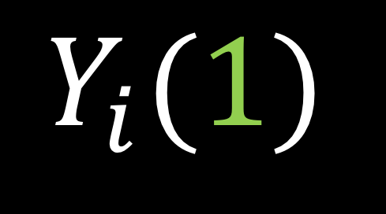

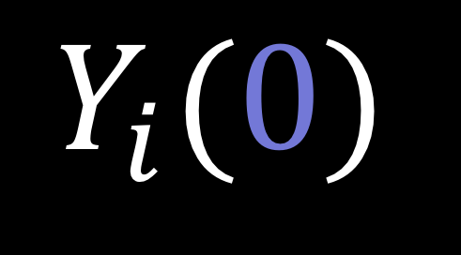
Potential outcomes
$$Y_{i}(0)$$
$$Y_{i}(1)$$
$$−$$
Notes:
In a study such as this, there are two potential outcomes for an individual I, Y i 0, _click_ the outcome if they are assigned the control and Y i 1, _click_ the outcome if they are assigned the treatment. Often our estimate of interest is the _click_ difference between these two outcomes. In reality, however only one of these two quantities is observable.

Slide 9
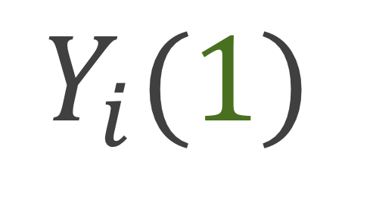
Potential outcomes
$$Y_{i}(0)$$
$$Y_{i}(1)$$
Notes:
If you are assigned the control, we can observe you Y i (0)

Slide 10
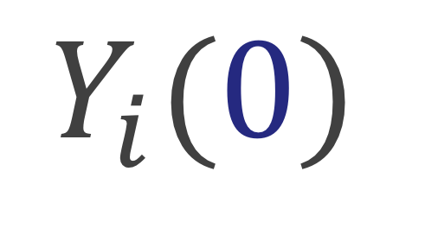
Potential outcomes
$$Y_{i}(0)$$
$$Y_{i}(1)$$
Notes:
And if you are assigned the treatment we can observe your Y i 1. This is often handled fundamentally as a missing data problem. While only one of these paired outcomes is observed, we can estimate what the other, the counterfactual, would have been had the participant received the opposite treatment.

Slide 11
Potential outcomes
$$Y_{i}(0)$$
$$Y_{i}(1)$$
$$−$$
Notes:
Ultimately, we are interested in some estimate of the treatment effect, for example we may want to know what the average treatment effect is across all participants, or we may want to know what the average treatment effect is among participants who received the treatment. I’m going to show you a few of these causal estimands and how we can estimate them using specific weights

Slide 12

Estimate treatment effect
$$\frac{\sum_{i=1}^{n}{Y_{i}Z_{i}}}{\sum_{i=1}^{n}{Z_{i}}}−\frac{\sum_{i=1}^{n}{Y_{i}\left(1−Z_{i}\right)}}{\sum_{i=1}^{n}{(1−Z_{i})}}$$
Notes:
In a randomized setting, we can just take the the difference between the mean outcome among the treated and the mean outcome among the controls

Slide 13

No unmeasured confounders
$$\left(Y\left(0\right),Y\left(1\right)\right)⊥Z|X$$
Notes:
In the observational study setting, given that there are no unmeasured confounders, which is often written in this way, that the potential outcomes are independent of treatment assignment given X, we can use propensity scores to estimate the average treatment effect

Slide 14

Propensity score
$$e_{i}=P(Z_{i}=1|X)$$
Notes:
the probability that you received treatment given your observed pre-treatment covariates. A lot of times we fit this with a logistic regression

Slide 15

Propensity score
$$e_{i}=P(Z_{i}=1|X)$$
$$w_{i}=f(e_{i})$$
Notes:
We can then create weights that are some function of the propensity score

Slide 16

Estimate treatment effect
$$\frac{\sum_{i=1}^{n}{Y_{i}Z_{i}w_{i}}}{\sum_{i=1}^{n}{Z_{i}w_{i}}}−\frac{\sum_{i=1}^{n}{Y_{i}\left(1−Z_{i}\right)w_{i}}}{\sum_{i=1}^{n}{\left(1−Z_{i}\right)w_{i}}}$$
Notes:
And incorporate these weights to estimate the treatment effect

Slide 17
Weighting
ATE Average treatment effect
ATM Average treatment effect among the evenly matchable
ATO Average treatment effect among the overlap population

Slide 18
Exploring finite-sample bias in propensity score weighting choices

Slide 19
Freedman & Berk Simulation

Slide 20
Doubly robust estimators
Fit a propensity score model
Fit an outcome model
Combine the two to estimate a treatment effect
As long as one is correctly specified, your result will be consistent

Slide 21
Doubly robust estimators
Lunceford and Davidian (2004) proved an unbiased estimator for the ATE
Li and Greene (2013) proved an unbiased estimator for the ATM
We proved an unbiased estimator for the ATO

Slide 22
Propensity score weighting method
Freedman & Berk use weights to estimate the “Average treatement effect”
Known to be unstable
Hypothesize that newer (more stable) weights will perform better
Notes:
These are known to be unstable because the weights can range from 0 to infinity

Slide 23
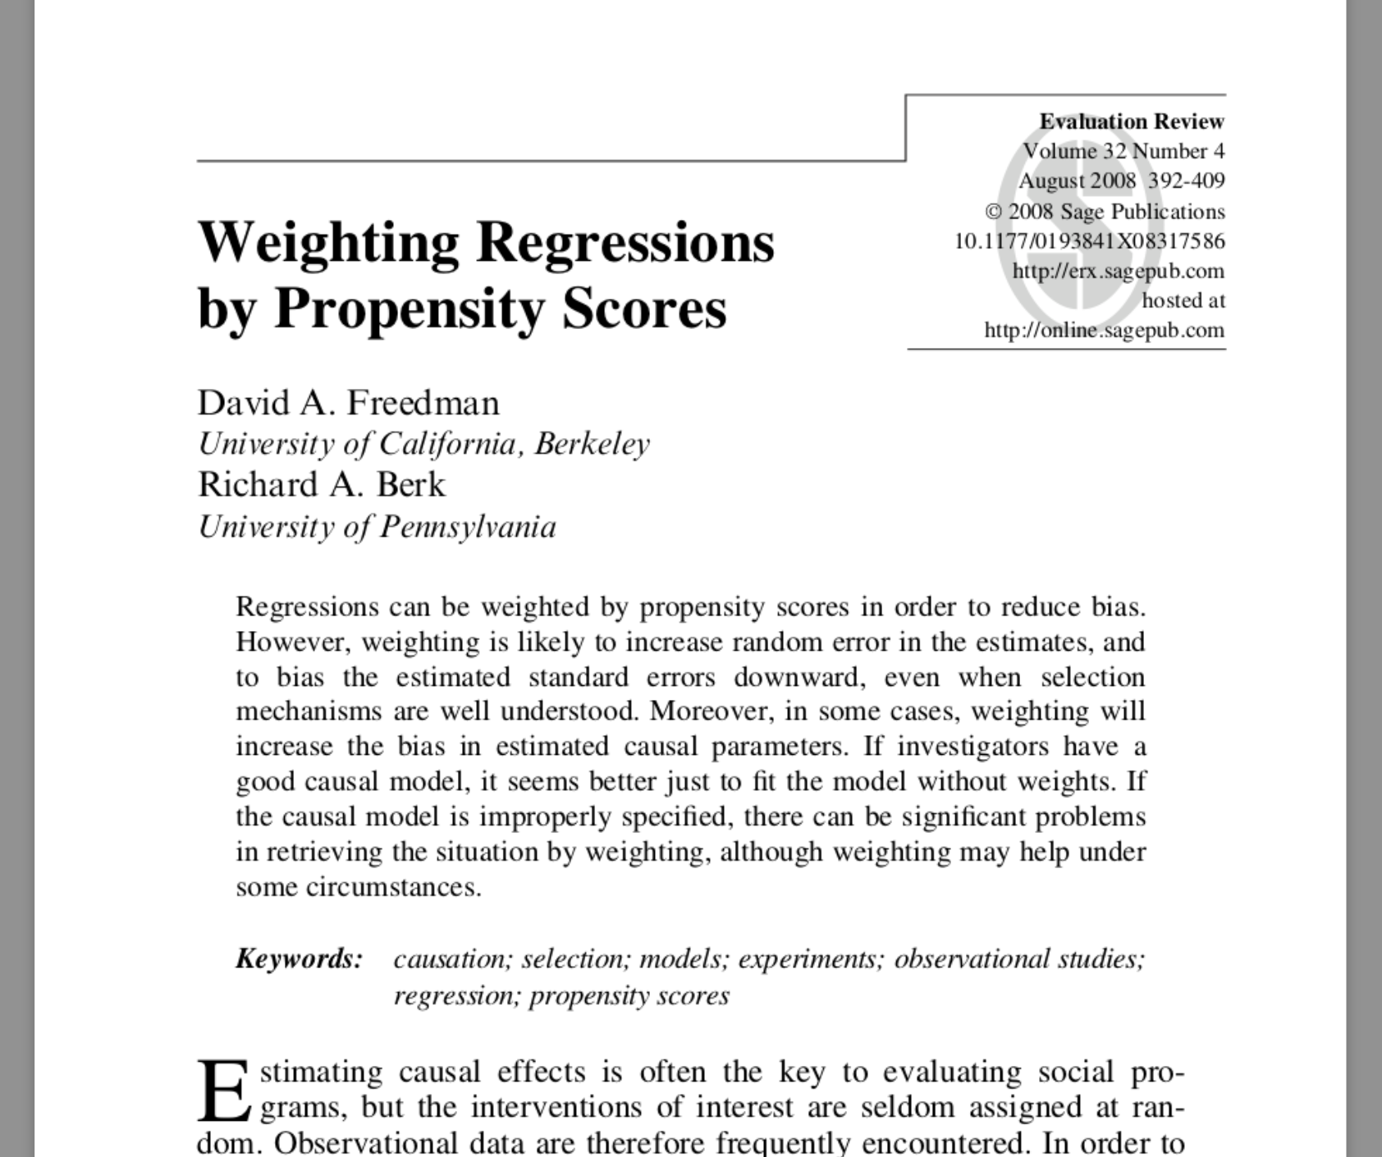
Notes:
In this setting, Freedman and Berk fit a correct propensity score model, and then fit a weighted outcome model that is misspecified

Slide 24
Fit a misspecified model
Allow the propensity score to be correct
The outcome model is missing a covariate

Slide 25

Average treatment effect
$$w_{ATE}=\frac{Z_{i}}{e_{i}}+\frac{{1 −Z}_{i}}{1 −e_{i}}$$

Slide 26
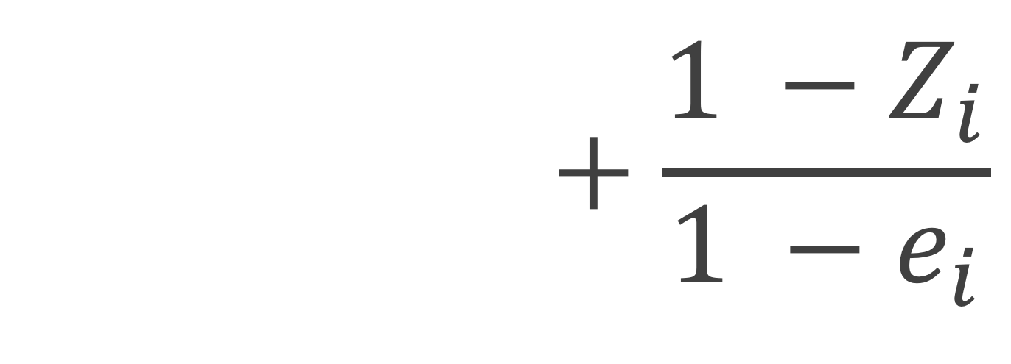
Average treatment effect
$$w_{ATE}=\frac{Z_{i}}{e_{i}}+\frac{{1 −Z}_{i}}{1 −e_{i}}$$

Slide 27

Average treatment effect
$$w_{ATE}=\frac{Z_{i}}{e_{i}}+\frac{{1 −Z}_{i}}{1 −e_{i}}$$

Slide 28
treatment
control

Slide 29
trt
control
Notes:
The dark portion, the grey, are the propensity scores the top part of the mirrored histogram is the treated population and the bottom, the upside-down histogram is the control population. Then the green represents the weighted propensity scores for the treated and the blue is the weighted propensity scores for the controls.
Add a legend - maybe don't need all of the hatches

Slide 30
trt
control
Notes:
The dark portion, the grey, are the propensity scores the top part of the mirrored histogram is the treated population and the bottom, the upside-down histogram is the control population. Then the green represents the weighted propensity scores for the treated and the blue is the weighted propensity scores for the controls.
Add a legend - maybe don't need all of the hatches

Slide 31

Average treatment effect among the evenly matchable
$$w_{ATM}=\frac{min\left\{e_{i}, 1−e_{i}\right\}}{{e_{i}Z}_{i}+(1 −e_{i})(1−Z_{i})}$$
Li & Greene (2013)
Notes:
Here, the ATM depends on some distance measure d to determine whether each participant is deemed “evenly matchable”, Md=1. The less prevalent exposure in any region of the covariate space, as defined by d, is matchable in the sense that they would readily find mates in a 1:1 within-caliper matching without replacement.
This estimand was defined by Laurie in her dissertation a last year.

Slide 32
treatment
control

Slide 33

Average treatment effect among the overlap population
$$w_{ATO}=\left(1−e_{i}\right)Z_{i}+ e_{i}(1−Z_{i})$$
Li et al (2016)

Slide 34
treatment
control

Slide 35
ATE
ATM
AT0

Slide 36
ATE
ATM
AT0

Slide 37
ATE
ATM
AT0

Slide 38
Freedman & Berk Simulation

Slide 39
x₁
x₂
z
y

Slide 40
1
x₁
x₂
0.25
2
0.75
1
z
1
y

Slide 41
1
x₁
x₂
0.25
2
0.75
1
z
1
y

Slide 42
1
x₁
x₂
0.25
2
0.75
1
z
1
y

Slide 43
1
x₁
x₂
0.25
2
0.75
1
z
1
y

Slide 44
1
x₁
x₂
0.25
2
0.75
1
z
1
y

Slide 45
Outcome model
x₁
x₂
z
y

Slide 46
Propensity score model
x₁
x₂
z
y

Slide 47
treatment
ctrl

Slide 50
Standard errors

Slide 52
Notes:
TODO change purple is harder to see

Slide 53
Recap
Replicated the finite-sample bias seen by Freedman and Berk using the ATE weights
ATM and ATO weights had improved finite-sample properties
The variance for the ATO and ATM is preferable to that of the ATE

Slide 54
Q&A

Slide 55
Doubly robust and large sample variance estimator for overlap weights

Slide 56
Derive large sample variance for the ATO Derive doubly robust estimator for ATO Simulate to compare to conventional methods

Slide 57

ATO estimator
$$\frac{\sum_{i=1}^{n}{\left(1−e\left(X_{i}, \hat{β}\right)\right)Z_{i}Y_{i}}}{\sum_{i=1}^{n}{\left(1−e\left(X_{i}, \hat{β}\right)\right)Z_{i}}}−\frac{\sum_{i=1}^{n}{e\left(X_{i}, \hat{β}\right){(1−Z}_{i})Y_{i}}}{\sum_{i=1}^{n}{e\left(X_{i}, \hat{β}\right)(1−Z_{i})}}$$

Slide 58
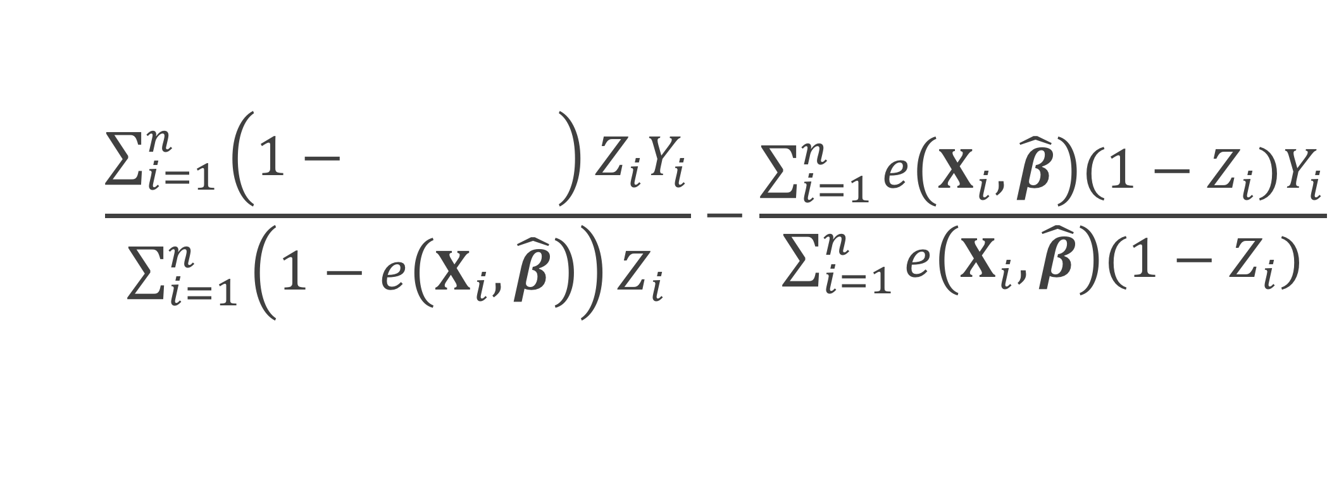
ATO estimator
$$\frac{\sum_{i=1}^{n}{\left(1−e\left(X_{i}, \hat{β}\right)\right)Z_{i}Y_{i}}}{\sum_{i=1}^{n}{\left(1−e\left(X_{i}, \hat{β}\right)\right)Z_{i}}}−\frac{\sum_{i=1}^{n}{e\left(X_{i}, \hat{β}\right){(1−Z}_{i})Y_{i}}}{\sum_{i=1}^{n}{e\left(X_{i}, \hat{β}\right)(1−Z_{i})}}$$
Notes:
Here I represent the fitted propensity score by e(Xi, beta hat) – this is often estimated by fitting a propensity score model using a logistic regression. Xi are the covariate values for participant I, beta hat are the betas obtained from the propensity score model.

Slide 59
ATO estimator
$$\frac{\sum_{i=1}^{n}{\left(1−e\left(X_{i}, \hat{β}\right)\right)Z_{i}Y_{i}}}{\sum_{i=1}^{n}{\left(1−e\left(X_{i}, \hat{β}\right)\right)Z_{i}}}−\frac{\sum_{i=1}^{n}{e\left(X_{i}, \hat{β}\right){(1−Z}_{i})Y_{i}}}{\sum_{i=1}^{n}{e\left(X_{i}, \hat{β}\right)(1−Z_{i})}}$$

Slide 60

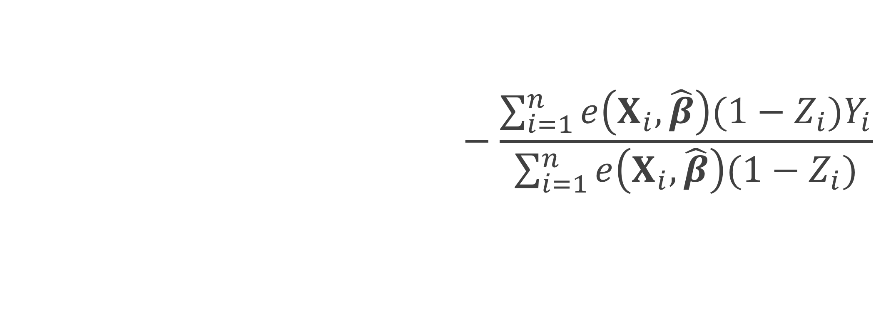
ATO estimator
$$\frac{\sum_{i=1}^{n}{\left(1−e\left(X_{i}, \hat{β}\right)\right)Z_{i}Y_{i}}}{\sum_{i=1}^{n}{\left(1−e\left(X_{i}, \hat{β}\right)\right)Z_{i}}}−\frac{\sum_{i=1}^{n}{e\left(X_{i}, \hat{β}\right){(1−Z}_{i})Y_{i}}}{\sum_{i=1}^{n}{e\left(X_{i}, \hat{β}\right)(1−Z_{i})}}$$
$${\hat{μ}}_{1}$$

Slide 61
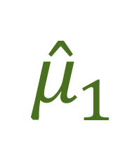
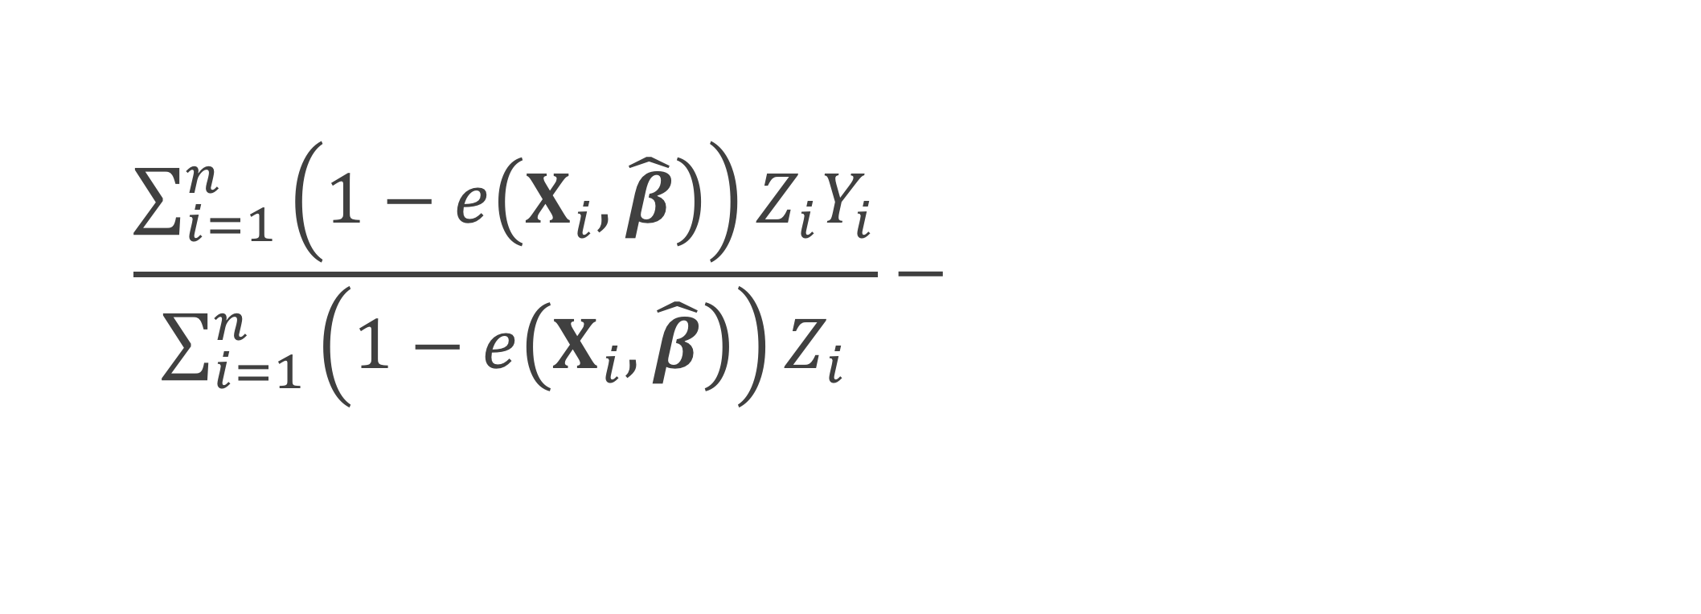

ATO estimator
$$\frac{\sum_{i=1}^{n}{\left(1−e\left(X_{i}, \hat{β}\right)\right)Z_{i}Y_{i}}}{\sum_{i=1}^{n}{\left(1−e\left(X_{i}, \hat{β}\right)\right)Z_{i}}}−\frac{\sum_{i=1}^{n}{e\left(X_{i}, \hat{β}\right){(1−Z}_{i})Y_{i}}}{\sum_{i=1}^{n}{e\left(X_{i}, \hat{β}\right)(1−Z_{i})}}$$
$${\hat{μ}}_{1}$$
$${\hat{μ}}_{0}$$

Slide 62
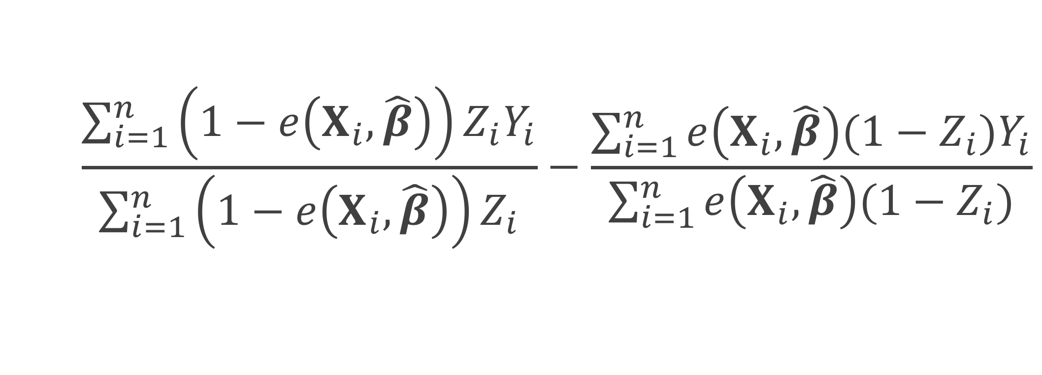

ATO estimator
$$\frac{\sum_{i=1}^{n}{\left(1−e\left(X_{i}, \hat{β}\right)\right)Z_{i}Y_{i}}}{\sum_{i=1}^{n}{\left(1−e\left(X_{i}, \hat{β}\right)\right)Z_{i}}}−\frac{\sum_{i=1}^{n}{e\left(X_{i}, \hat{β}\right){(1−Z}_{i})Y_{i}}}{\sum_{i=1}^{n}{e\left(X_{i}, \hat{β}\right)(1−Z_{i})}}$$
$${\hat{μ}}_{1}$$
$$−$$
$${\hat{μ}}_{0}$$

Slide 63
How to
Plug in
Fit a weighted generalized linear model Y ~ Z

Slide 64
How to
Plug in
Fit a weighted generalized linear model Y ~ Z
But what about the variance?
Pull from the GLM?
Robust standard errors? (sandwich estimator)
Notes:
These robust standard errors do no take into account the fact that you fit a propensity score prior to fitting your weighted GLM

Slide 65
Williamson 2013
“
…ignoring the estimation of the propensity score in the calculation of the variance leads to the erroneous conclusion that the IPTW treatment effect estimator has the same variance as an unadjusted estimator; thus, it is important to use a variance estimator that correctly takes into account the estimation of the propensity score.
”

Slide 66


ATO estimator
ATO weight
$$u\left(θ\right)=\left(\begin{matrix}\left(Y−μ_{1}\right)Z\left(1−e\left(X, β\right)\right) \\ \left(Y−μ_{0}\right)\left(1−Z\right)e\left(X, β\right) \\ X\left(Z−e\left(X, β\right)\right)\end{matrix}\right)$$
$$θ={\left(μ_{1}, μ_{0},β^{T}\right)}^{T}$$

Slide 67
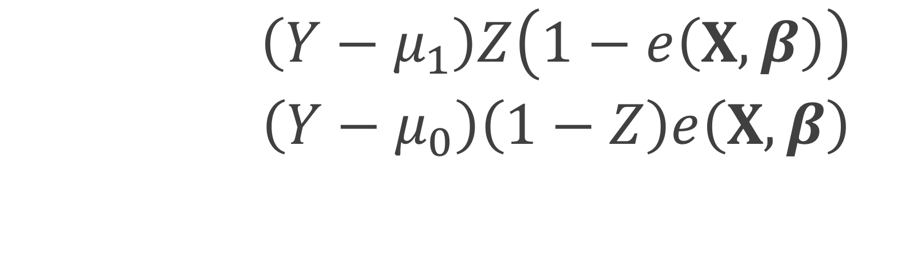
ATO estimator
$$u\left(θ\right)=\left(\begin{matrix}\left(Y−μ_{1}\right)Z\left(1−e\left(X, β\right)\right) \\ \left(Y−μ_{0}\right)\left(1−Z\right)e\left(X, β\right) \\ X\left(Z−e\left(X, β\right)\right)\end{matrix}\right)$$
$$θ={\left(μ_{1}, μ_{0},β^{T}\right)}^{T}$$

Slide 68

ATO estimator
$$0=\sum_{i=1}^{n}{u_{i}\left(θ\right)}$$
$$θ={\left(μ_{1}, μ_{0},β^{T}\right)}^{T}$$
Notes:
we can estimate the propensity score and the treatment effect simultaneously in one step by solving the following estimating equations with respect to theta

Slide 69

M-Estimation
$$\sqrt{n}\left(\hat{θ}−θ\right)\underset{→}{d}N(0, A^{−1}BA^{−T})$$
Notes:
Since these estimating equations are unbiased, U of theta is an example of an M-estimator. The asymptotic distribution of an M estimator is the following.

Slide 70

Sandwich estimator
$$A^{−1}BA^{−T}$$

Slide 71

Sandwich estimator
$$A^{−1}BA^{−T}$$
$$A=−E\left[\frac{∂u\left(θ\right)}{∂θ}\right]$$

Slide 72


$$θ={\left(μ_{1}, μ_{0},β^{T}\right)}^{T}$$
$$u\left(θ\right)=\left(\begin{matrix}\left(Y−μ_{1}\right)Z\left(1−e\left(X, β\right)\right) \\ \left(Y−μ_{0}\right)\left(1−Z\right)e\left(X, β\right) \\ X\left(Z−e\left(X, β\right)\right)\end{matrix}\right)$$
$$A=−E\left[\frac{∂u\left(θ\right)}{∂θ}\right]$$

Slide 73
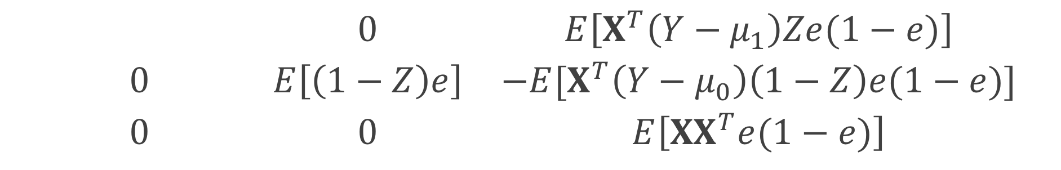
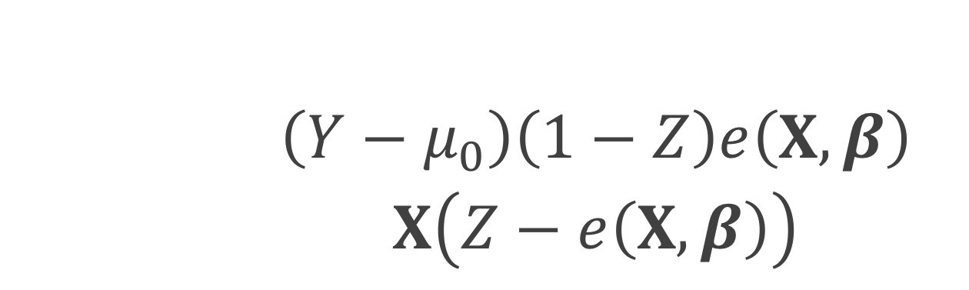
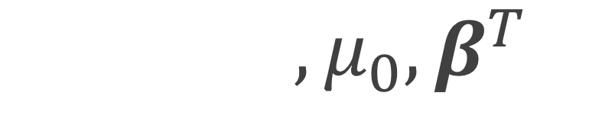
$$θ={\left(μ_{1}, μ_{0},β^{T}\right)}^{T}$$
$$u\left(θ\right)=\left(\begin{matrix}\left(Y−μ_{1}\right)Z\left(1−e\left(X, β\right)\right) \\ \left(Y−μ_{0}\right)\left(1−Z\right)e\left(X, β\right) \\ X\left(Z−e\left(X, β\right)\right)\end{matrix}\right)$$
$$\left(\begin{matrix}E\left[Z(1−e)\right] & 0 & E\left[X^{T}\left(Y−μ_{1}\right)Ze(1−e)\right] \\ 0 & E\left[\left(1−Z\right)e\right] & −E[X^{T}\left(Y−μ_{0}\right)\left(1−Z\right)e(1−e)] \\ 0 & 0 & E\left[{XX}^{T}e(1−e)\right]\end{matrix}\right)$$

Slide 74

$$θ={\left(μ_{1}, μ_{0},β^{T}\right)}^{T}$$
$$u\left(θ\right)=\left(\begin{matrix}\left(Y−μ_{1}\right)Z\left(1−e\left(X, β\right)\right) \\ \left(Y−μ_{0}\right)\left(1−Z\right)e\left(X, β\right) \\ X\left(Z−e\left(X, β\right)\right)\end{matrix}\right)$$
$$\left(\begin{matrix}E\left[Z(1−e)\right] & 0 & E\left[X^{T}\left(Y−μ_{1}\right)Ze(1−e)\right] \\ 0 & E\left[\left(1−Z\right)e\right] & −E[X^{T}\left(Y−μ_{0}\right)\left(1−Z\right)e(1−e)] \\ 0 & 0 & E\left[{XX}^{T}e(1−e)\right]\end{matrix}\right)$$

Slide 75

Sandwich estimator
$$A^{−1}BA^{−T}$$
$B=E\left[u\left(θ\right)u{\left(θ\right)}^{T}\right]$

Slide 76



$B=E\left[u\left(θ\right)u{\left(θ\right)}^{T}\right]$
$$B=E\left[\left(\begin{matrix}\left(Y−μ_{1}\right)Z\left(1−e\left(X, β\right)\right) \\ \left(Y−μ_{0}\right)\left(1−Z\right)e\left(X, β\right) \\ X\left(Z−e\left(X, β\right)\right)\end{matrix}\right)× \right.$$
$$\left.{\left(\begin{matrix}\left(Y−μ_{1}\right)Z\left(1−e\left(X, β\right)\right) \\ \left(Y−μ_{0}\right)\left(1−Z\right)e\left(X, β\right) \\ X\left(Z−e\left(X, β\right)\right)\end{matrix}\right)}^{T}\right]$$

Slide 77

Sandwich estimator
$$\hat{var}\left(\hat{θ}\right)=\frac{1}{n}{{\hat{A}}_{n}}^{−1}{\hat{B}}_{n}{{\hat{A}}_{n}}^{−T}$$
Notes:
We can replace the expectations by the sample average to get an approximate large sample variance

Slide 78

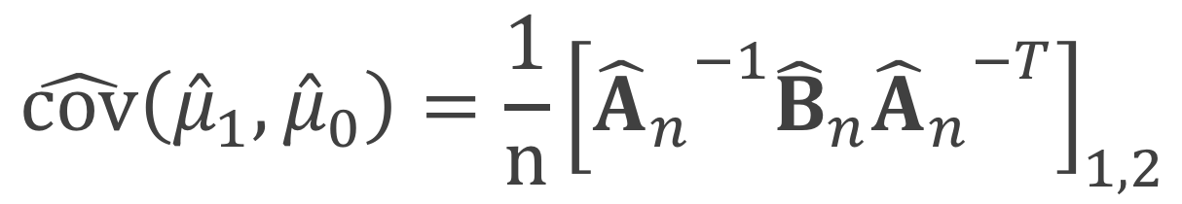
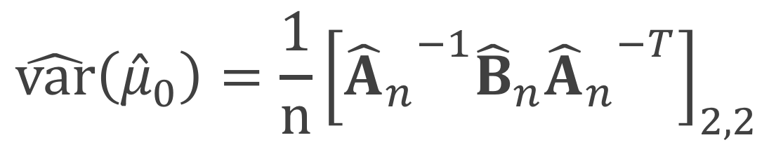
Sandwich estimator
$$\hat{var}\left({\hat{μ}}_{1}\right)=\frac{1}{n}{\left[{{\hat{A}}_{n}}^{−1}{\hat{B}}_{n}{{\hat{A}}_{n}}^{−T}\right]}_{1,1}$$
$$\hat{var}\left({\hat{μ}}_{0}\right)=\frac{1}{n}{\left[{{\hat{A}}_{n}}^{−1}{\hat{B}}_{n}{{\hat{A}}_{n}}^{−T}\right]}_{2,2}$$
$$\hat{cov}\left({{\hat{μ}}_{1},\hat{μ}}_{0}\right)=\frac{1}{n}{\left[{{\hat{A}}_{n}}^{−1}{\hat{B}}_{n}{{\hat{A}}_{n}}^{−T}\right]}_{1,2}$$
Notes:
use brackets instead of parentheses

Slide 79
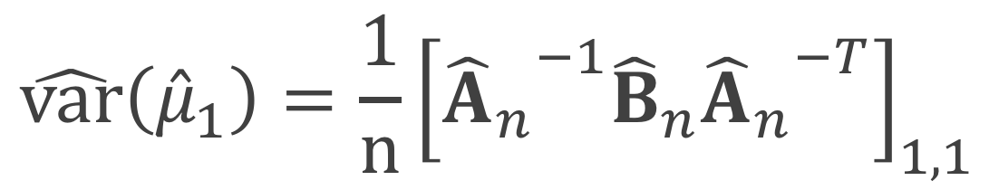

Sandwich estimator
$$\hat{var}\left({\hat{μ}}_{1}\right)=\frac{1}{n}{\left[{{\hat{A}}_{n}}^{−1}{\hat{B}}_{n}{{\hat{A}}_{n}}^{−T}\right]}_{1,1}$$
$$\hat{var}\left({\hat{μ}}_{0}\right)=\frac{1}{n}{\left[{{\hat{A}}_{n}}^{−1}{\hat{B}}_{n}{{\hat{A}}_{n}}^{−T}\right]}_{2,2}$$
$$\hat{cov}\left({{\hat{μ}}_{1},\hat{μ}}_{0}\right)=\frac{1}{n}{\left[{{\hat{A}}_{n}}^{−1}{\hat{B}}_{n}{{\hat{A}}_{n}}^{−T}\right]}_{1,2}$$
Notes:
use brackets instead of parentheses

Slide 80

Sandwich estimator
$$\hat{var}\left({\hat{μ}}_{1}\right)=\frac{1}{n}{\left[{{\hat{A}}_{n}}^{−1}{\hat{B}}_{n}{{\hat{A}}_{n}}^{−T}\right]}_{1,1}$$
$$\hat{var}\left({\hat{μ}}_{0}\right)=\frac{1}{n}{\left[{{\hat{A}}_{n}}^{−1}{\hat{B}}_{n}{{\hat{A}}_{n}}^{−T}\right]}_{2,2}$$
$$\hat{cov}\left({{\hat{μ}}_{1},\hat{μ}}_{0}\right)=\frac{1}{n}{\left[{{\hat{A}}_{n}}^{−1}{\hat{B}}_{n}{{\hat{A}}_{n}}^{−T}\right]}_{1,2}$$
Notes:
use brackets instead of parentheses

Slide 81
Sandwich estimator
$$\hat{var}\left({\hat{μ}}_{1}\right)=\frac{1}{n}{\left[{{\hat{A}}_{n}}^{−1}{\hat{B}}_{n}{{\hat{A}}_{n}}^{−T}\right]}_{1,1}$$
$$\hat{var}\left({\hat{μ}}_{0}\right)=\frac{1}{n}{\left[{{\hat{A}}_{n}}^{−1}{\hat{B}}_{n}{{\hat{A}}_{n}}^{−T}\right]}_{2,2}$$
$$\hat{cov}\left({{\hat{μ}}_{1},\hat{μ}}_{0}\right)=\frac{1}{n}{\left[{{\hat{A}}_{n}}^{−1}{\hat{B}}_{n}{{\hat{A}}_{n}}^{−T}\right]}_{1,2}$$
Notes:
use brackets instead of parentheses

Slide 82
What if we want to also adjust the outcome model?

Slide 83
How to
Fit a weighted generalized linear model Y ~ Z + X
Doubly robust estimator
Notes:
Fit a single weighted generalized linear model, with the Xs included – this is commonly what I have seen done in the literature – under the continuous case, using a GLM with a identity link, this is essentially a doubly robust estimator
Use a doubly robust estimator where we fit two models, one among the treated and one among the controls and combine them using the weights

Slide 84
How to
Fit a weighted generalized linear model Y ~ Z + X
Doubly robust estimator
But what about the variance?
Pull from the GLM?
Robust standard errors? (sandwich estimator)
Notes:
But what about the variance? Again if we are fitting a single model, we can pull the variances directly from the GLM or we can use robust standard errors, however the robust standard errors from a GLM won’t incorporate the fact that the propensity scores are not fixed. Alternatively, we can use the doubly robust estimator and fit an updated large-sample variance that incorporates the propensity score model

Slide 85

ATO DR estimator
$${\hat{Δ}}_{DR, ATO}={\hat{δ}}_{1}+{\hat{δ}}_{2}−{\hat{δ}}_{3}$$
Notes:
We can write the doubly robust estimator for the ATO in 3 equations, delta 1, delta2 and delta 3

Slide 86
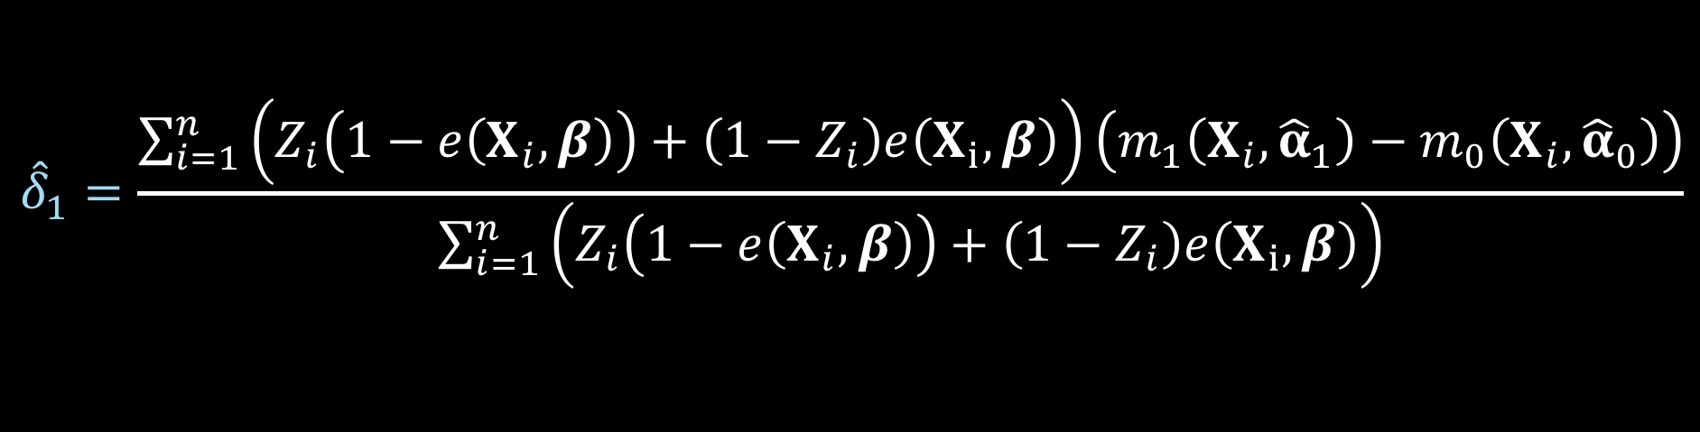
ATO DR estimator
$${\hat{Δ}}_{DR, ATO}={\hat{δ}}_{1}+{\hat{δ}}_{2}−{\hat{δ}}_{3}$$
$${\hat{δ}}_{1}=\frac{\sum_{i=1}^{n}{\left(Z_{i}\left(1−e\left(X_{i},β\right)\right)+\left(1−Z_{i}\right)e\left(X_{i}, β\right)\right)\left(m_{1}\left(X_{i},{\hat{α}}_{1}\right)−m_{0}\left(X_{i}, {\hat{α}}_{0}\right)\right)}}{\sum_{i=1}^{n}{\left(Z_{i}\left(1−e\left(X_{i},β\right)\right)+\left(1−Z_{i}\right)e\left(X_{i}, β\right)\right)}}$$
Notes:
Here is delta 1

Slide 87
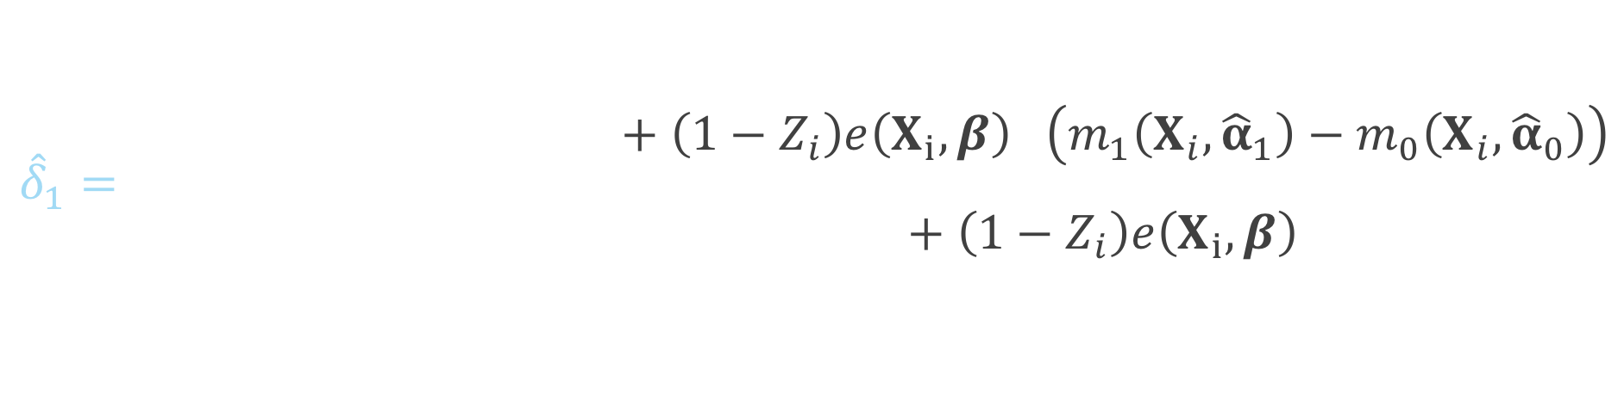
ATO DR estimator
$${\hat{Δ}}_{DR, ATO}={\hat{δ}}_{1}+{\hat{δ}}_{2}−{\hat{δ}}_{3}$$
$${\hat{δ}}_{1}=\frac{\sum_{i=1}^{n}{\left(Z_{i}\left(1−e\left(X_{i},β\right)\right)+\left(1−Z_{i}\right)e\left(X_{i}, β\right)\right)\left(m_{1}\left(X_{i},{\hat{α}}_{1}\right)−m_{0}\left(X_{i}, {\hat{α}}_{0}\right)\right)}}{\sum_{i=1}^{n}{\left(Z_{i}\left(1−e\left(X_{i},β\right)\right)+\left(1−Z_{i}\right)e\left(X_{i}, β\right)\right)}}$$
Notes:
This will be weighted by 1 minus the propensity score for the treated

Slide 88
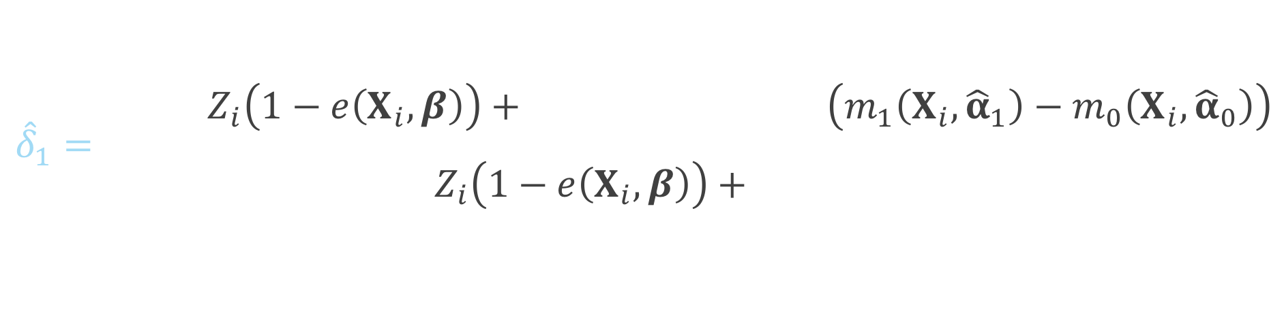
ATO DR estimator
$${\hat{Δ}}_{DR, ATO}={\hat{δ}}_{1}+{\hat{δ}}_{2}−{\hat{δ}}_{3}$$
$${\hat{δ}}_{1}=\frac{\sum_{i=1}^{n}{\left(Z_{i}\left(1−e\left(X_{i},β\right)\right)+\left(1−Z_{i}\right)e\left(X_{i}, β\right)\right)\left(m_{1}\left(X_{i},{\hat{α}}_{1}\right)−m_{0}\left(X_{i}, {\hat{α}}_{0}\right)\right)}}{\sum_{i=1}^{n}{\left(Z_{i}\left(1−e\left(X_{i},β\right)\right)+\left(1−Z_{i}\right)e\left(X_{i}, β\right)\right)}}$$
Notes:
And the propensity score for the controls

Slide 89
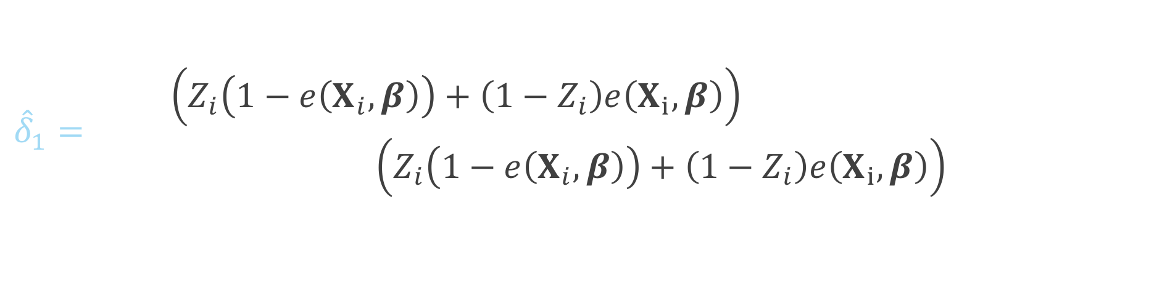
ATO DR estimator
$${\hat{Δ}}_{DR, ATO}={\hat{δ}}_{1}+{\hat{δ}}_{2}−{\hat{δ}}_{3}$$
$${\hat{δ}}_{1}=\frac{\sum_{i=1}^{n}{\left(Z_{i}\left(1−e\left(X_{i},β\right)\right)+\left(1−Z_{i}\right)e\left(X_{i}, β\right)\right)\left(m_{1}\left(X_{i},{\hat{α}}_{1}\right)−m_{0}\left(X_{i}, {\hat{α}}_{0}\right)\right)}}{\sum_{i=1}^{n}{\left(Z_{i}\left(1−e\left(X_{i},β\right)\right)+\left(1−Z_{i}\right)e\left(X_{i}, β\right)\right)}}$$
Notes:
Here is the difference between the Y predicted among the treated and the Y predicted among the controls

Slide 90
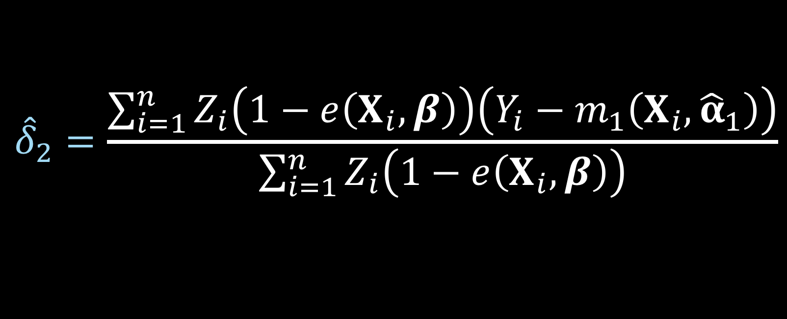
ATO DR estimator
$${\hat{Δ}}_{DR, ATO}={\hat{δ}}_{1}+{\hat{δ}}_{2}−{\hat{δ}}_{3}$$
$${\hat{δ}}_{2}=\frac{\sum_{i=1}^{n}{Z_{i}\left(1−e\left(X_{i},β\right)\right)\left(Y_{i}−m_{1}\left(X_{i},{\hat{α}}_{1}\right)\right)}}{\sum_{i=1}^{n}{Z_{i}\left(1−e\left(X_{i},β\right)\right)}}$$
Notes:
Here is delta 2

Slide 91
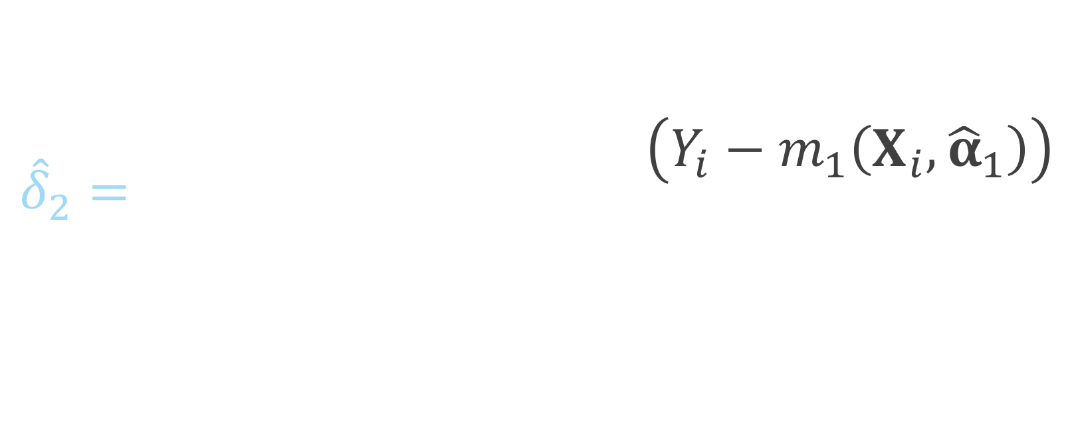
ATO DR estimator
$${\hat{Δ}}_{DR, ATO}={\hat{δ}}_{1}+{\hat{δ}}_{2}−{\hat{δ}}_{3}$$
$${\hat{δ}}_{2}=\frac{\sum_{i=1}^{n}{Z_{i}\left(1−e\left(X_{i},β\right)\right)\left(Y_{i}−m_{1}\left(X_{i},{\hat{α}}_{1}\right)\right)}}{\sum_{i=1}^{n}{Z_{i}\left(1−e\left(X_{i},β\right)\right)}}$$
Notes:
Notice this is just among the treated, so if the subject i is in the control group, this will be zero, since Zi will be 0

Slide 92
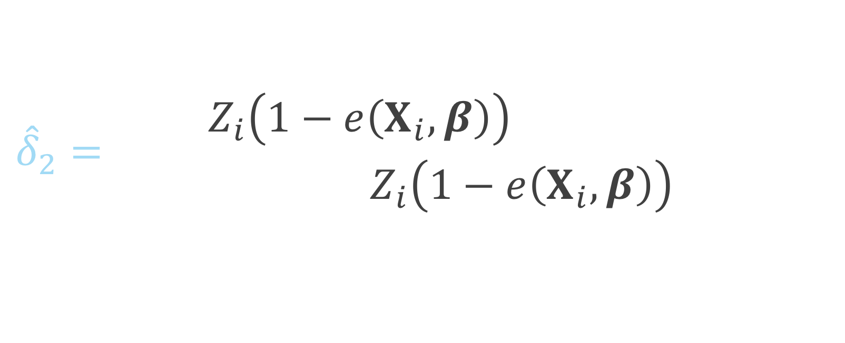
ATO DR estimator
$${\hat{Δ}}_{DR, ATO}={\hat{δ}}_{1}+{\hat{δ}}_{2}−{\hat{δ}}_{3}$$
$${\hat{δ}}_{2}=\frac{\sum_{i=1}^{n}{Z_{i}\left(1−e\left(X_{i},β\right)\right)\left(Y_{i}−m_{1}\left(X_{i},{\hat{α}}_{1}\right)\right)}}{\sum_{i=1}^{n}{Z_{i}\left(1−e\left(X_{i},β\right)\right)}}$$
Notes:
This piece is essentially the residual between the observed Y among the treated and the predicted Y among the treated

Slide 93
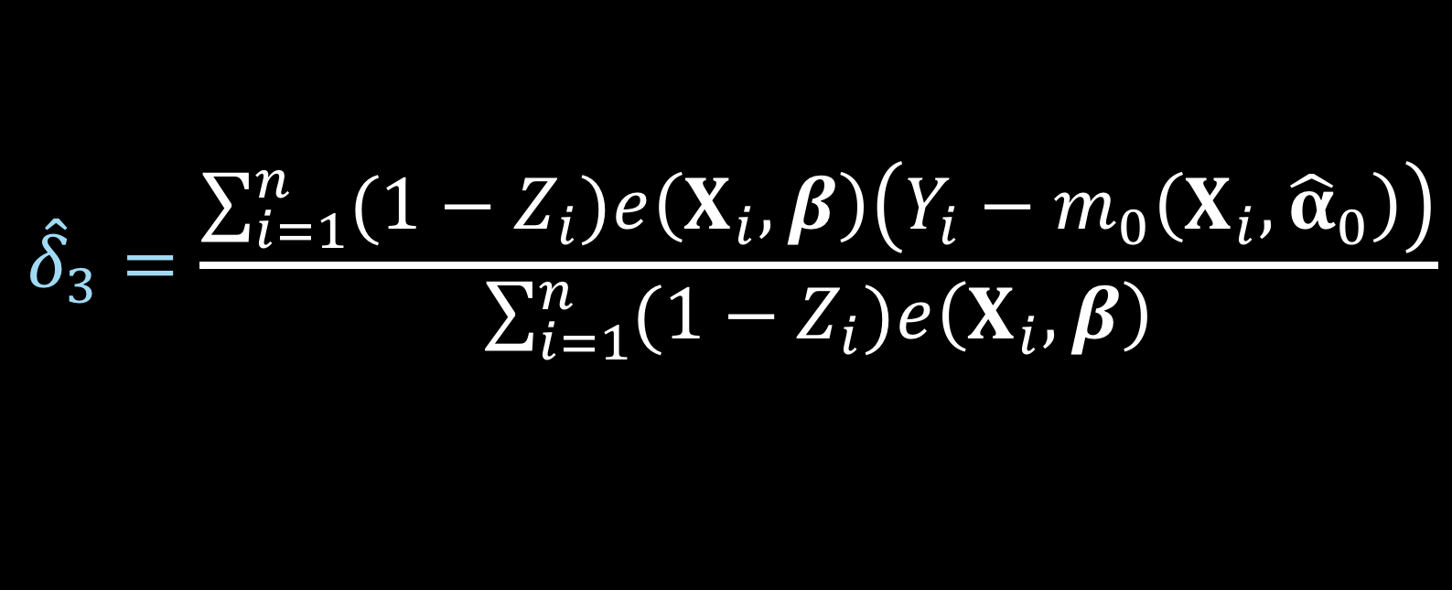
ATO DR estimator
$${\hat{Δ}}_{DR, ATO}={\hat{δ}}_{1}+{\hat{δ}}_{2}−{\hat{δ}}_{3}$$
$${\hat{δ}}_{3}=\frac{\sum_{i=1}^{n}{{(1−Z}_{i})e\left(X_{i},β\right)\left(Y_{i}−m_{0}\left(X_{i},{\hat{α}}_{0}\right)\right)}}{\sum_{i=1}^{n}{{(1−Z}_{i})e\left(X_{i},β\right)}}$$
Notes:
Here is delta 3

Slide 94
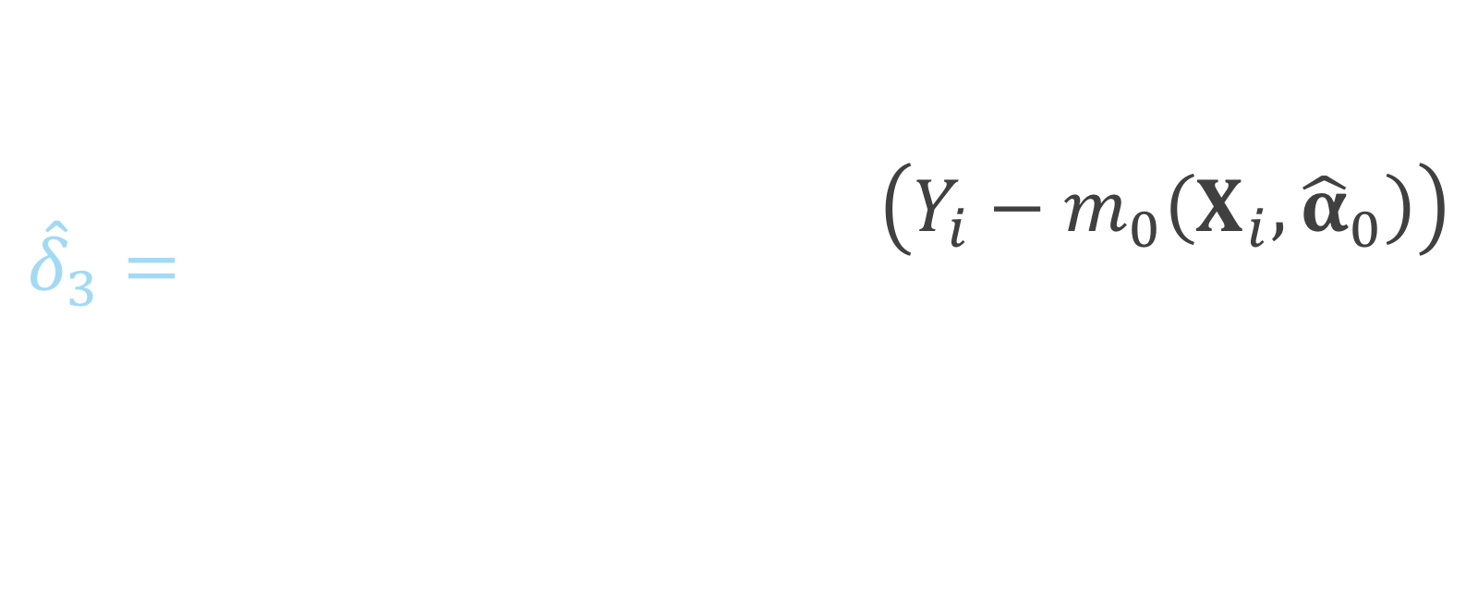
ATO DR estimator
$${\hat{Δ}}_{DR, ATO}={\hat{δ}}_{1}+{\hat{δ}}_{2}−{\hat{δ}}_{3}$$
$${\hat{δ}}_{3}=\frac{\sum_{i=1}^{n}{{(1−Z}_{i})e\left(X_{i},β\right)\left(Y_{i}−m_{0}\left(X_{i},{\hat{α}}_{0}\right)\right)}}{\sum_{i=1}^{n}{{(1−Z}_{i})e\left(X_{i},β\right)}}$$
Notes:
This summation is just among the controls, if the participant is in the treated group, 1 – Zi will be 0

Slide 95
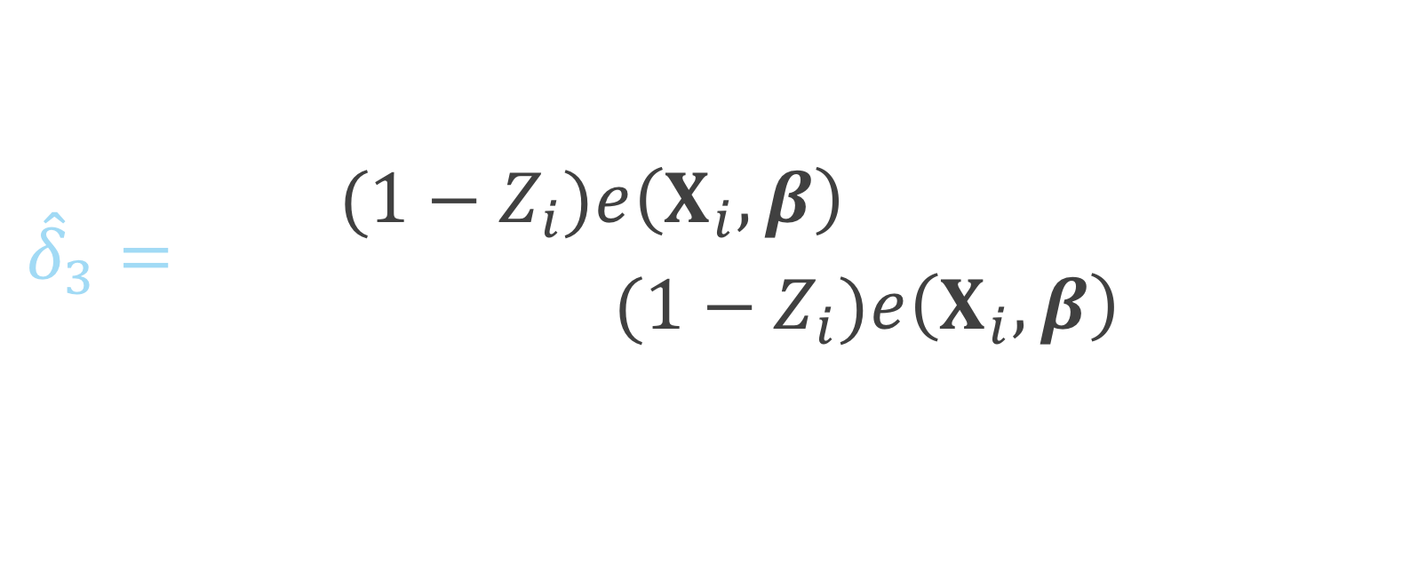
ATO DR estimator
$${\hat{Δ}}_{DR, ATO}={\hat{δ}}_{1}+{\hat{δ}}_{2}−{\hat{δ}}_{3}$$
$${\hat{δ}}_{3}=\frac{\sum_{i=1}^{n}{{(1−Z}_{i})e\left(X_{i},β\right)\left(Y_{i}−m_{0}\left(X_{i},{\hat{α}}_{0}\right)\right)}}{\sum_{i=1}^{n}{{(1−Z}_{i})e\left(X_{i},β\right)}}$$
Notes:
And this is the residual of the observed y among the controls and the predicted y, fit among the controls

Slide 96


ATO DR estimator
$$u\left(θ\right)=\left(\begin{matrix}(m_{1}\left(X, α_{1}\right)−m_{0}\left(X, α_{0}\right)−δ_{1})(Z\left(1−e\left(X,β\right)\right)+\left(1−Z\right)e\left(X,β\right)) \\ \left(Y−m_{1}\left(X, α_{1}\right)−δ_{2}\right)Z(1−e\left(X,β\right)) \\ \begin{aligned}\left(Y−m_{0}\left(X, α_{0}\right)−δ_{3}\right)\left(1−Z\right)e\left(X, β\right) \\ \left(Y−m_{1}\left(X,α_{1}\right)\right)ZX \\ \left(Y−m_{0}\left(X,α_{0}\right)\right)\left(1−Z\right)X \\ X\left(Z−e\left(X,β\right)\right)\end{aligned}\end{matrix}\right)$$
$$θ={\left(δ_{1}, δ_{2},δ_{3},α_{1}^{T},α_{0}^{T},β^{T}\right)}^{T}$$
Notes:
Again this can be solved by simultaneously solving these estimating equations. Note here that this technically will only be correct if both the outcome model AND the propensity score model are correctly specified.

Slide 97
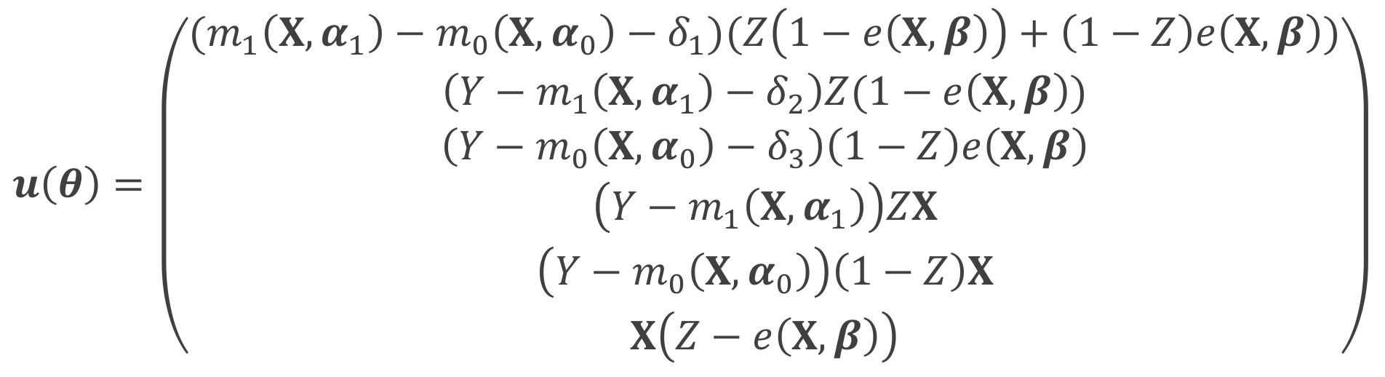
ATO DR estimator
$$u\left(θ\right)=\left(\begin{matrix}(m_{1}\left(X, α_{1}\right)−m_{0}\left(X, α_{0}\right)−δ_{1})(Z\left(1−e\left(X,β\right)\right)+\left(1−Z\right)e\left(X,β\right)) \\ \left(Y−m_{1}\left(X, α_{1}\right)−δ_{2}\right)Z(1−e\left(X,β\right)) \\ \begin{aligned}\left(Y−m_{0}\left(X, α_{0}\right)−δ_{3}\right)\left(1−Z\right)e\left(X, β\right) \\ \left(Y−m_{1}\left(X,α_{1}\right)\right)ZX \\ \left(Y−m_{0}\left(X,α_{0}\right)\right)\left(1−Z\right)X \\ X\left(Z−e\left(X,β\right)\right)\end{aligned}\end{matrix}\right)$$
$$θ={\left(δ_{1}, δ_{2},δ_{3},α_{1}^{T},α_{0}^{T},β^{T}\right)}^{T}$$
Notes:
This is more complicated than the large-sample variance that we derived for the ATO IPW estimator because now we have more parameters to solve for, rather than just mu1, mu0 and beta, we now have delta 1 2 and 3, and alpha 1 and 0 from the outcome models

Slide 98

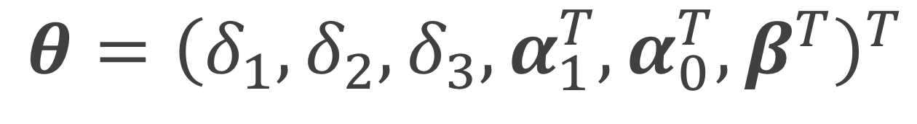
ATO DR estimator
$$u\left(θ\right)=\left(\begin{matrix}(m_{1}\left(X, α_{1}\right)−m_{0}\left(X, α_{0}\right)−δ_{1})(Z\left(1−e\left(X,β\right)\right)+\left(1−Z\right)e\left(X,β\right)) \\ \left(Y−m_{1}\left(X, α_{1}\right)−δ_{2}\right)Z(1−e\left(X,β\right)) \\ \begin{aligned}\left(Y−m_{0}\left(X, α_{0}\right)−δ_{3}\right)\left(1−Z\right)e\left(X, β\right) \\ \left(Y−m_{1}\left(X,α_{1}\right)\right)ZX \\ \left(Y−m_{0}\left(X,α_{0}\right)\right)\left(1−Z\right)X \\ X\left(Z−e\left(X,β\right)\right)\end{aligned}\end{matrix}\right)$$
$$θ={\left(δ_{1}, δ_{2},δ_{3},α_{1}^{T},α_{0}^{T},β^{T}\right)}^{T}$$
Notes:
These first 3 lines are the estimating equations that make up the 3 parts of the doubly robust equation we just went through

Slide 99
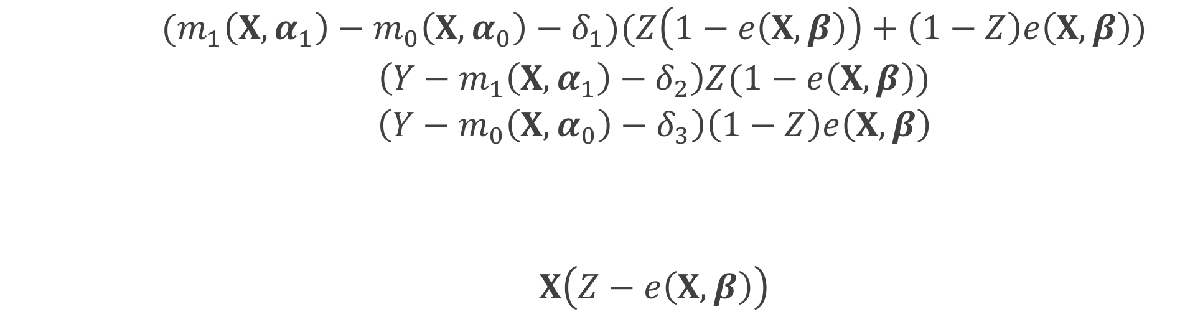
ATO DR estimator
$$u\left(θ\right)=\left(\begin{matrix}(m_{1}\left(X, α_{1}\right)−m_{0}\left(X, α_{0}\right)−δ_{1})(Z\left(1−e\left(X,β\right)\right)+\left(1−Z\right)e\left(X,β\right)) \\ \left(Y−m_{1}\left(X, α_{1}\right)−δ_{2}\right)Z(1−e\left(X,β\right)) \\ \begin{aligned}\left(Y−m_{0}\left(X, α_{0}\right)−δ_{3}\right)\left(1−Z\right)e\left(X, β\right) \\ \left(Y−m_{1}\left(X,α_{1}\right)\right)ZX \\ \left(Y−m_{0}\left(X,α_{0}\right)\right)\left(1−Z\right)X \\ X\left(Z−e\left(X,β\right)\right)\end{aligned}\end{matrix}\right)$$
$$θ={\left(δ_{1}, δ_{2},δ_{3},α_{1}^{T},α_{0}^{T},β^{T}\right)}^{T}$$
Notes:
These two are the estimating equations for fitting the outcome models, the top is for the outcome model among the treated, the bottom is the outcome model among the controls

Slide 100
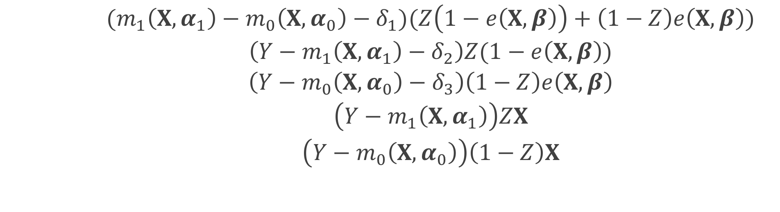
ATO DR estimator
$$u\left(θ\right)=\left(\begin{matrix}(m_{1}\left(X, α_{1}\right)−m_{0}\left(X, α_{0}\right)−δ_{1})(Z\left(1−e\left(X,β\right)\right)+\left(1−Z\right)e\left(X,β\right)) \\ \left(Y−m_{1}\left(X, α_{1}\right)−δ_{2}\right)Z(1−e\left(X,β\right)) \\ \begin{aligned}\left(Y−m_{0}\left(X, α_{0}\right)−δ_{3}\right)\left(1−Z\right)e\left(X, β\right) \\ \left(Y−m_{1}\left(X,α_{1}\right)\right)ZX \\ \left(Y−m_{0}\left(X,α_{0}\right)\right)\left(1−Z\right)X \\ X\left(Z−e\left(X,β\right)\right)\end{aligned}\end{matrix}\right)$$
$$θ={\left(δ_{1}, δ_{2},δ_{3},α_{1}^{T},α_{0}^{T},β^{T}\right)}^{T}$$
Notes:
This final equation accounts for the propensity score model

Slide 101
Sandwich estimator
$$A^{−1}BA^{−T}$$
Notes:
Again, we are using the sandwich estimator to approximate the large sample variance

Slide 102
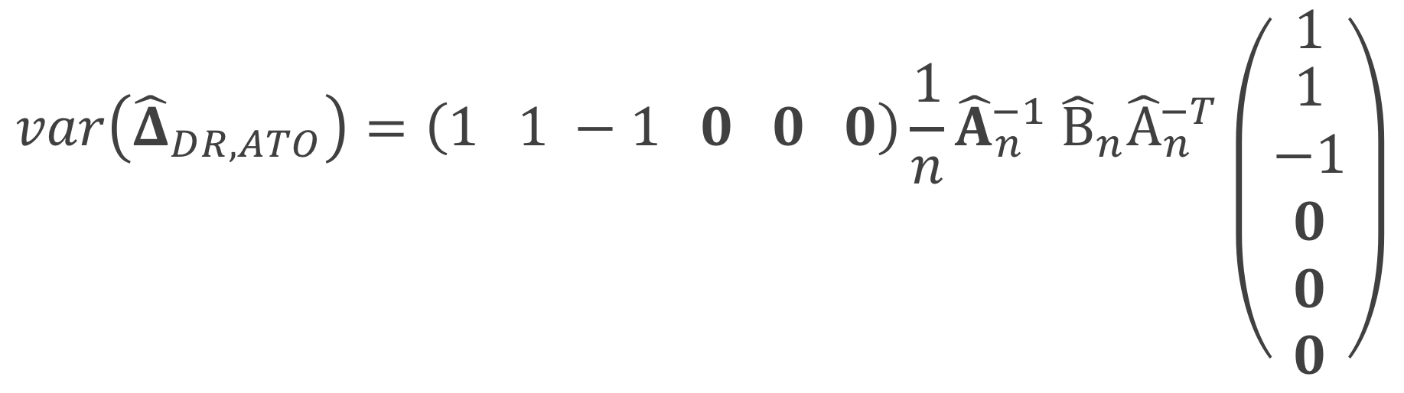
ATO DR estimator
$${\hat{Δ}}_{DR, ATO}={\hat{δ}}_{1}+{\hat{δ}}_{2}−{\hat{δ}}_{3}$$
$$var\left({\hat{Δ}}_{DR, ATO}\right)=\left(1 1 −1 0 0 0\right){\frac{1}{n}\hat{A}}_{n}^{−1} {\hat{B}}_{n}{\hat{A}}_{n}^{−T}\left({1 \atop \begin{aligned}1 \\ −1 \\ 0 \\ 0 \\ 0\end{aligned}}\right)$$
Notes:
Because we are estimating delta 1 plus delta 2 minus delta 3, after we estimate our sandwich estimator

Slide 103

ATO DR estimator
$${\hat{Δ}}_{DR, ATO}={\hat{δ}}_{1}+{\hat{δ}}_{2}−{\hat{δ}}_{3}$$
$$\hat{var}\left({\hat{Δ}}_{DR, ATO}\right)=\left(1 1 −1 0 0 0\right){\frac{1}{n}\hat{A}}_{n}^{−1} {\hat{B}}_{n}{\hat{A}}_{n}^{−T}\left({1 \atop \begin{aligned}1 \\ −1 \\ 0 \\ 0 \\ 0\end{aligned}}\right)$$
Notes:
This will be our variance estimator where

Slide 104
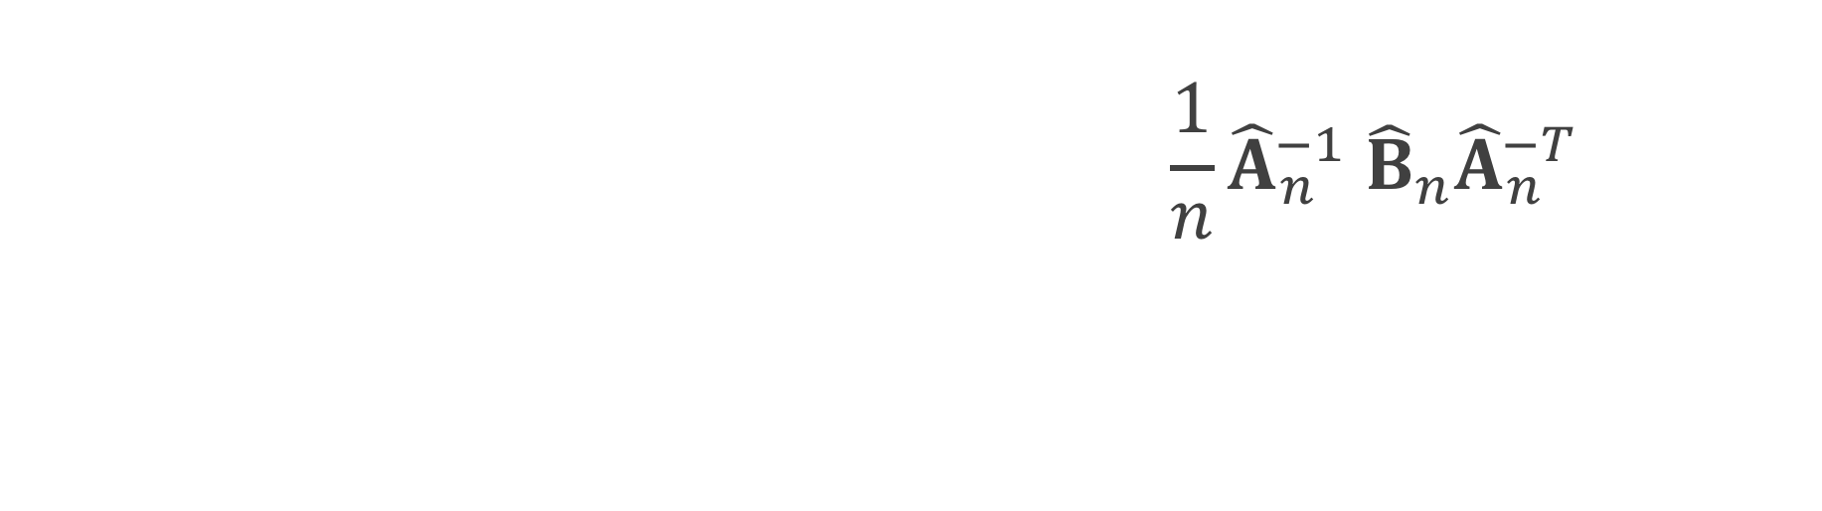
ATO DR estimator
$${\hat{Δ}}_{DR, ATO}={\hat{δ}}_{1}+{\hat{δ}}_{2}−{\hat{δ}}_{3}$$
$$\hat{var}\left({\hat{Δ}}_{DR, ATO}\right)=\left(1 1 −1 0 0 0\right){\frac{1}{n}\hat{A}}_{n}^{−1} {\hat{B}}_{n}{\hat{A}}_{n}^{−T}\left({1 \atop \begin{aligned}1 \\ −1 \\ 0 \\ 0 \\ 0\end{aligned}}\right)$$
Notes:
We will multiply by the vector 1 1 -1 with the remaining entries 0 on both sides

Slide 105
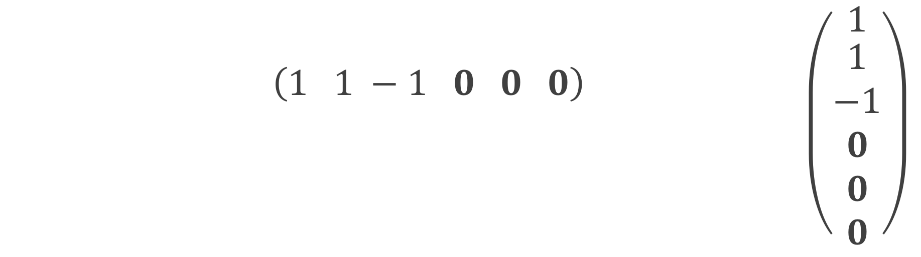
ATO DR estimator
$${\hat{Δ}}_{DR, ATO}={\hat{δ}}_{1}+{\hat{δ}}_{2}−{\hat{δ}}_{3}$$
$$\hat{var}\left({\hat{Δ}}_{DR, ATO}\right)=\left(1 1 −1 0 0 0\right){\frac{1}{n}\hat{A}}_{n}^{−1} {\hat{B}}_{n}{\hat{A}}_{n}^{−T}\left({1 \atop \begin{aligned}1 \\ −1 \\ 0 \\ 0 \\ 0\end{aligned}}\right)$$
Notes:
We multiply by our estimated sandwich estimator where we've plugged in our sample averages for the expectations

Slide 106
Freedman & Berk* Simulation

Slide 107
1
x₁
x₂
0.25
3
0.75
1
z
1
y

Slide 108
correct-correct correct-wrong wrong-correct wrong-wrong
Notes:
We have 4 settings, and in fact we actually have 6, because we observe 3 different settings in the wrong-wrong case

Slide 109
correct-correct correct-wrong wrong-correct wrong-wrong

Slide 110
correct-correct correct-wrong wrong-correct wrong-wrong

Slide 111
correct-correct correct-wrong wrong-correct wrong-wrong

Slide 112
correct-correct correct-wrong wrong-correct wrong-wrong
extreme
moderate
slight

Slide 113
x₁
x₂
z
y

Slide 114
bias ratio estimated se / true se RMSE 95% coverage

Slide 115
bias ratio estimated se / true se RMSE 95% coverage

Slide 116
correct-correct

Slide 117
correct-correct

Slide 118
correct-wrong

Slide 119
correct-wrong

Slide 120
wrong-correct

Slide 121
wrong-correct

Slide 122
wrong-wrong

Slide 123
wrong-wrong

Slide 124
wrong-wrong

Slide 125
wrong-wrong
Notes:
Even here, in a less extreme case (we’ve made the size of the unmeasured confounder pretty small) you still see by the time N = 5000, the bias fully takes over the variance, pulling the coverage to 0.

Slide 126
Recap
Derived the DR estimator and large sample variance for ATO
Compared to conventional methods
When the outcome model is correctly specified, robust standard errors obtained from a generalized linear model perform well, otherwise our large-sample variance is preferred
If a confounder is completely left out, we need alternative methods to adjust for the bias

Slide 127
Q&A
Notes:
- missing a covariate - can you fix it with weighting?
- give the intuition - if you have a model and you condition on all the covariates, weighting doesn't matter, if you leave out a covariate you can weight
- we changed this robust-robust estimator
- bootstrap - conservative?

Slide 128
Contextualized Tipping Point Sensitivity Analyses for Unmeasured Confounding

Slide 129
Motivation
Review of 90 observational studies JAMA, NEJM, and AJE
41 mentioned the issue of unmeasured confounding as a limitation
4 performed a quantitative sensitivity analysis
Notes:
We conducted a review of 90 observational studies with statistically significant findings published in 2015 in the Journal of the American Medical Association, the New England Journal of Medicine, and the American Journal of Epidemiology. 41 (45.6%) mentioning the issue of unmeasured confounding as a limitation and only 4 (4.4%) performing a quantitative sensitivity analysis.

Slide 130
What we want
Simplified
Transparent
Contextualized
Notes:
We want a sensitivity analysis that is simplified, ideally can be summarized in a single line in a manuscript

Slide 131
What we want
Simplified
Transparent
Contextualized
Notes:
I want you to provide details in your manuscript such that I could conduct my own sensitivity analysis if I think the pieces you included are insufficient

Slide 132
What we want
Simplified
Transparent
Contextualized
Notes:
Contextualized, we want it to be grounded in the analysis that was conducted

Slide 133
Simplified

Slide 134

Binary unmeasured confounder
$$RR_{adj}=RR_{obs}\frac{RR_{UD}p_{0}+(1−p_{0})}{RR_{UD}p_{1}+(1−p_{1})}$$
Lin et al (1998)
Notes:
So here is the main equation that we use for binary unmeasured confounders. Basically we’re adjusting our observed exposure-outcome effect using quantities representing an unmeasured confounder to get an exposure-outcome effect that adjusts for the unmeasured confounder

Slide 135
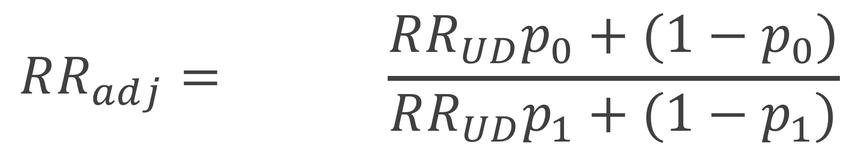
Binary unmeasured confounder
$$RR_{adj}=RR_{obs}\frac{RR_{UD}p_{0}+(1−p_{0})}{RR_{UD}p_{1}+(1−p_{1})}$$
Notes:
Here RR obs is the effect between the treatment and outcome that you have observed, I denote this as RR, but Lin et al show that this could be an odds ratio or a hazard ratio in most settings

Slide 136
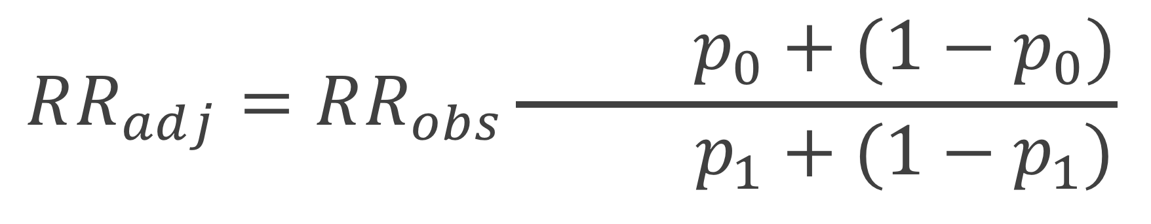
Binary unmeasured confounder
$$RR_{adj}=RR_{obs}\frac{RR_{UD}p_{0}+(1−p_{0})}{RR_{UD}p_{1}+(1−p_{1})}$$
Notes:
RR UD is the relative risk of the unmeasured confounder and the outcome – again this can be replaced with an odds ratio or hazard ratio

Slide 137
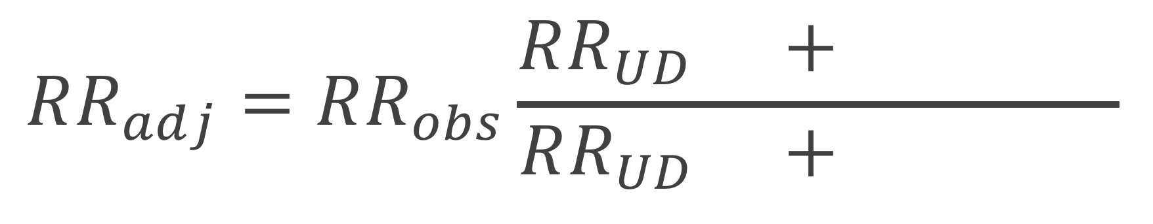
Binary unmeasured confounder
$$RR_{adj}=RR_{obs}\frac{RR_{UD}p_{0}+(1−p_{0})}{RR_{UD}p_{1}+(1−p_{1})}$$
Notes:
P0 and p1 are the prevalence of the unmeasured confounder in the unexposed and exposed populations

Slide 138

Binary unmeasured confounder
$$LB_{adj}=LB_{obs}\frac{RR_{UD}p_{0}+(1−p_{0})}{RR_{UD}p_{1}+(1−p_{1})}$$
Notes:
We can replace the exposure – outcome point estimate with the limiting bound of the exposure outcome effect (meaning the effect closest to the null)

Slide 139

Tipping point analyses
what will tip our confidence bound to cross 1

Slide 140

Binary unmeasured confounder
$$1=LB_{obs}\frac{RR_{UD}p_{0}+(1−p_{0})}{RR_{UD}p_{1}+(1−p_{1})}$$
Notes:
To create a tipping point, we can set the adjusted effect to 1 (the null), and solve for RRUD, p0 or p1

Slide 141

Binary unmeasured confounder
$$RR_{UD}\left(LB_{obs}, p_{0}, p_{1}\right)=\frac{\left(1−p_{1}\right)+LB_{obs}(p_{0}−1)}{LB_{obs}p_{0}−p_{1}}$$
Notes:
For example here we’ve solved for RR_UD – so if you provide the prevalences of an unmeasured confounder, you can solve for the association between the unmeasured confounder and outcome needed to tip your observed effect to inconclusive

Slide 142

Continuous unmeasured confounder
$$LB_{adj}=\frac{LB_{obs}}{RR_{UD}^{μ_{1}−μ_{0}}}$$
Lin et al (1998)
Notes:
We can also have a continuous unmeasured confounder, where it is assumed to be normally distributed with a mean mu and variance 1. The variance is assumed to be 1. Any normally distributed confounder can fit this specification by scaling by the standard deviation within each exposure group.

Slide 143
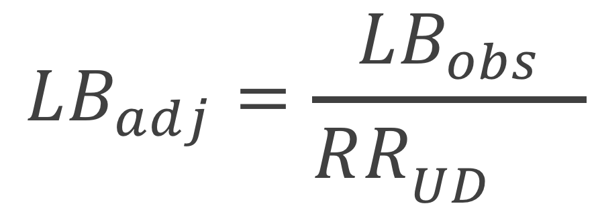
Continuous unmeasured confounder
$$LB_{adj}=\frac{LB_{obs}}{RR_{UD}^{μ_{1}−μ_{0}}}$$
Notes:
Mu1 is the mean of the unmeasured confounder in the exposed population and mu 0 is the mean of the unmeasured confounder in the unexposed population

Slide 144
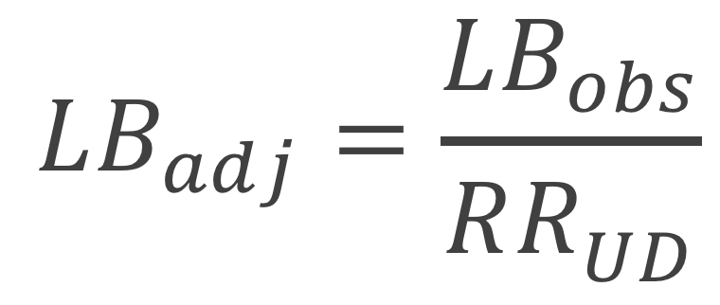
Continuous unmeasured confounder
$$LB_{adj}=\frac{LB_{obs}}{RR_{UD}^{δ}}$$
Notes:
For simplicity, we can replace this difference with delta

Slide 145

Continuous unmeasured confounder
$$δ\left(LB_{obs}, RR_{UD}\right)=\frac{\log\left(LB_{obs}\right)}{\log\left(RR_{UD}\right)}$$
Notes:
We can again set the adjusted limiting bound to 1 and solve for any of the quantities, for example here we’ve solved for delta

Slide 146

Continuous unmeasured confounder
$$n\left(LB_{obs}, RR_{UD}, δ\right)=\frac{\log\left(LB_{obs}\right)}{δ\log\left(RR_{UD}\right)}$$
Notes:
Or we can even solve for n, how many independent unmeasured confounders of a certain size and mean difference would be needed to tip your analysis

Slide 147

“Assumption free”
$$1=LB_{obs}\frac{RR_{UD}/RR_{EU}+\left(1−1/RR_{EU}\right)}{RR_{UD}}$$
Ding and VanderWeele (2016)
Notes:
Ding and Vanderweele build on this same methodology to create what they call an “assumption free” analysis, so you don’t have to assume whether the unmeasured confounder is continuous or binary

Slide 148
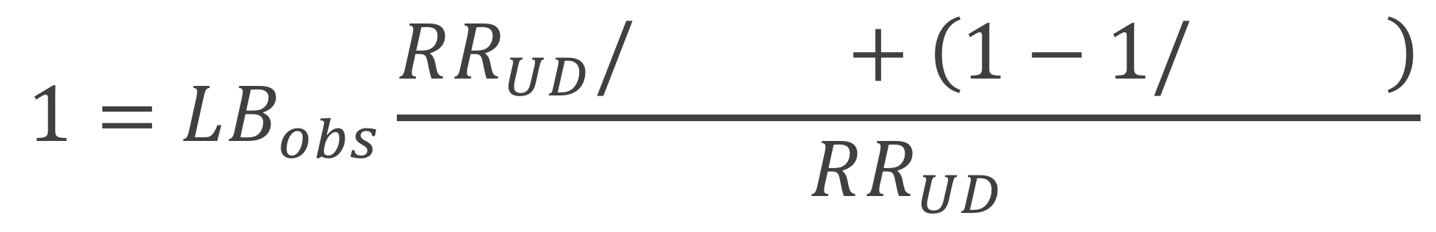
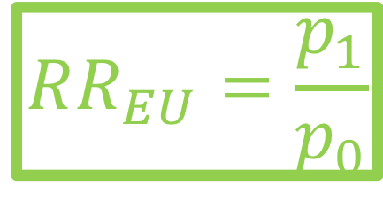
“Assumption free”
$$1=LB_{obs}\frac{RR_{UD}/RR_{EU}+\left(1−1/RR_{EU}\right)}{RR_{UD}}$$
$$RR_{EU}=\frac{p_{1}}{p_{0}}$$
Notes:
Here RR_EU is the relationship between the unmeasured confounder and the exposure, the way they are able to summarize this in a single number for the binary case, rather than with p1 and p0 is they set p1 to 1

Slide 149
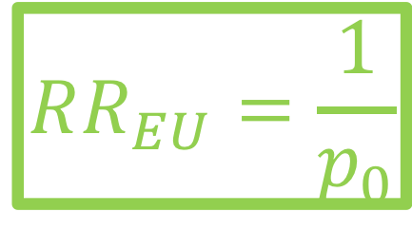
“Assumption free”
$$1=LB_{obs}\frac{RR_{UD}/RR_{EU}+\left(1−1/RR_{EU}\right)}{RR_{UD}}$$
$$RR_{EU}=\frac{1}{p_{0}}$$

Slide 150
E-value
$$E−value=LB_{obs}+\sqrt{LB_{obs}×(LB_{obs}−1)}$$
Ding and VanderWeele (2017)
Notes:
Vanderweele and Ding also rearrange their equation to be what they call an E-value, the point that minimizes the strength of association, on the risk ratio scale, that an unmeasured confounder would need to have with both the exposure and outcome, conditional on the measured covariates, to explain away an observed exposure-outcome association. This offers a great solution if you don’t have any idea for what kind of unmeasured confounder may be out there, but it has the disadvantage of being a bit hard to interpret in the context of your measured covariates

Slide 151

Adjusted E-value
$$E−{value}_{adj}=\frac{LB_{obs}}{LB_{adj}}+\sqrt{\frac{LB_{obs}}{LB_{adj}}×\left(\frac{LB_{obs}}{LB_{adj}}−1\right)}$$
Notes:
For this reason, we’ve used similar methodology to create an adjusted e-value, where we allow you to input the value you are trying to adjust to, rather than always setting the adjusted limiting bound to one. I will demonstrate soon how we can use this with our observed covariates

Slide 152
Transparent

Slide 153
Demonstrate balance
Table 1
Standardized mean differences / Love plots
Side-by-side boxplots / ECDFs
Observed bias plots
Notes:
Include a Table 1 with prevalences/means for the exposed and unexposed, standardized mean differences, potentially as a Love plot, side-by-side boxplots and ECDFs, and observed bias plots

Slide 154
Right Heart Catheterization data
We chose 20 covariates for demonstration purposes
demographics
comorbidities
physiological measurements
diagnosis categories
APACHE score
SUPPORT (probability of surviving 2 months)
DNR status on day 1
Connors et al (2006)
Notes:
This dataset is assessing the effectiveness of right heart catheterization (RHC) in the initial care of critically ill patients.
We chose 20 covariates to include for demonstration purposes
Demographics
Comorbidities
Physiological measurements
Diagnosis categories
APACHE score
SUPPORT model estimate of the probability of surviving 2 months
DNR status on day 1

Slide 155
Right Heart Catheterization data
Fit a propensity score model
Use ATO weights
Fit weighted cox model for 30 day survival
Notes:
This dataset is assessing the effectiveness of right heart catheterization (RHC) in the initial care of critically ill patients.
We chose 20 covariates to include for demonstration purposes
Demographics
Comorbidities
Physiological measurements
Diagnosis categories
APACHE score
SUPPORT model estimate of the probability of surviving 2 months
DNR status on day 1

Slide 156
Notes:
The balance is quite lovely, in fact ATO weights have the excellent property that they will be exactly balanced on the mean for any covariate included in the propensity score model.

Slide 157
Notes:
We also examine side-by-side boxplots and empirical CDF for continuous covariates, here is an example for the covariate that initially had the largest standardized mean difference, APACHE score. The distribution looks quite nice post weighting.

Slide 158
Notes:
I’m going to spend a minute on this plot -- this is a plot we’ve come up with that we’re calling an ”observed bias plot” the light blue shaded region shows the confidence interval for the observed exposure – outcome effect with all covariates included in the analysis, so here the effect between RHC and 30 day survival, in our case it is about (1.11 to 1.37). The blue line down the center is the observed point estimate, in this case it is a hazard ratio around 1.24. Each black line is the exposure-outcome effect that would have been observed had the covariate indicated not been observed. For example this top one here _click_ is the observed effect between RHC and 30 day survival if we had not observed DNR status on day 1 _click_. The purple stars represent the “adjusted E-values” These represent what the E-value would be if the *only* unmeasured confounder that were missing is the one that is dropped. So this E-value here _click_ represents what the E-value would be if DNR status on day 1 were the only missing covariate. This gives some contextualization to the E-value, allowing you to imagine it in the context of your observed covariates

Slide 159
Notes:
We also include additional values at the bottom _click_ where we can observe what happens if we leave out groups of variables, such as Labs or physiological measurements. This begins to get at the question “what if we are missing a lot of unmeasured confounders”. We then also plot what an unmeasured confounder that would tip the analysis at the Lower Bound and at the point estimate would look like, along with the associated E-value.

Slide 160
Contextualize

Slide 161
R package
tipr
tip_with_binary()
tip_with_continuous()

Slide 162
Scenario 1
library(tipr)
tip_with_continuous(mean_diff = 0.29,
lb = 1.11,
ub = 1.37)
#> [1] 1.433132
Notes:
In this first scenario, we are concerned that there may be an unmeasured confounder with imbalance similar to that of “APACHE Score”, as evidence by the magnitude of the standardized mean difference in the Love plot _click_. The scaled mean APACHE score among the exposed is 3 and the scaled APACHE score among the unexposed is 2.71. We can calculate the size of an unmeasured confounder needed to tip this analysis given a mean difference of 0.29. _click_ This lets a researcher state
Examining one of our most imbalanced covariates, APACHE score, we observe a scaled mean difference of 0.29. A hypothetical unobserved continuous confounder that has a mean difference of 0.29 between exposure groups would need to have an association with 30 day survival (HR) of 1.43 to tip this analysis at the 5% level, rendering it inconclusive.

Slide 163
Scenario 2
library(tipr)
tip_with_binary(p_0 = 0.14,
gamma = 2.59,
lb = 1.11,
ub = 1.37)
#> [1] 0.2245824
Notes:
In this scenario, we have a covariate that is highly associated with the outcome and are interested in calculating how imbalanced an unmeasured confounder of the same magnitude would need to be in order to tip the analysis. Here we’ll choose DNR status as our observed covariate of interest, since it has a large association with the outcome. DNR status has an adjusted association with 30 day survival (HR) of 2.59 Since this is a binary confounder, the prevalence in the unexposed population is necessary in order to calculate the prevalence in the exposed population needed to tip this analysis. The prevalence of DNR status in the unexposed population is 0.14. _click_ This let’s us state “Examining one of our covariates most highly associated with 30 day survival, we observe an adjusted association of 2.59. A hypothetical unobserved binary confounder that is prevalent in 14% of the unexposed population with an association of 2.59 with 30 day survival would need to be prevalent in 22.46% of the exposed population to tip this analysis at the 5% level, rendering it inconclusive.”
TODO tip_with_binary

Slide 164
Scenario 3
library(tipr)
tip_with_continuous(mean_diff = -0.19,
gamma = 1/1.05,
lb = 1.11,
ub = 1.37)
#> [1] 11.25766
Notes:
rather than being concerned with a single unmeasured confounder of the magnitude of one that was observed, we are interested in the effect of multiple independent unmeasured confounders. Using the RHC example, many of the physiological measurements, (bilirubin, hematocrit, white blood cell count, mean blood pressure, PaO2/FiO2 ratio, albumin, respiratory rate, PaCO2, heart rate), resulted in very small associations with the outcome, all less than 1.05 (or the inverse, 0.95). How many unmeasured confounders of this magnitude would it take to tip our analysis to render it inconclusive? In order to calculate this quantity for a continuous unmeasured confounder, we will need to specify the mean difference between the exposed and unexposed groups. Examining the Love plot we can again choose the observed confounder that is the most imbalanced to ground this analysis, for example for _click_ mean blood pressure. The scaled mean difference in mean blood pressure between exposure groups is -0.19. _click_ This let’s us state It would take at least 11 more independent unmeasured confounders with a scaled mean difference between exposure groups of 0.19 to and an association with 30 day survival (HR) of 1.05 tip the observed analysis at the 5% level, rendering it inconclusive.

Slide 165
Scenario 4
Notes:
Given the observed lower bound of 1.11, the associated E-value is 1.46. Examining Observed bias plot we can add some context to this value. The only associated E-value close to this is that for DNR status on day 1. This implies that we would need to be missing an additional independent covariate akin to DNR status on day 1 in order to tip our analysis. Even dropping all physiological measurements would not reach an E-value great enough to tip this study to inconclusive.

Slide 166
Recap
Rearranged sensitivity analysis formulas to create a tipping point analysis
Adjusted the E-value to allow it to be contextualized
Created tipr, an R package to perform these analysis
Demonstrated scenarios for contextualizing these analyses

Slide 167
Q&A

